Slide 1
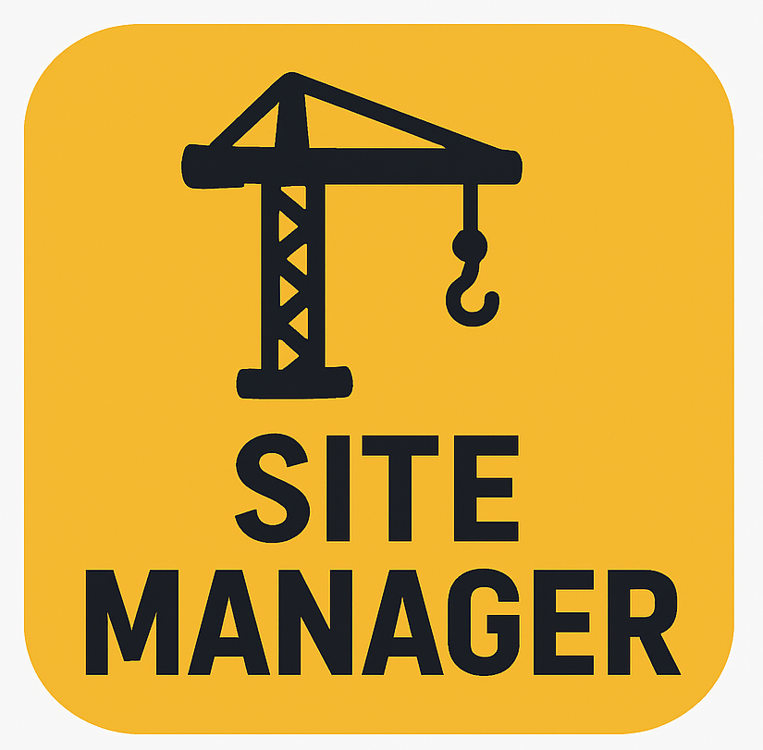

SiteManager
“Right people. Right equipment. Right on time.”

Slide 2

Concept Video
Human Computer Interface
Semester Project Phase 4
Joseph Koop, Kelvin Gordon, Enrique Garcia

Slide 3
Solution Overview
Construction companies need a digital dashboard to track all projects, employees, and equipment in one place because current systems lack real-time visibility and lead to inefficiencies.
Our solution is to create a live map that links to projects and shows exactly which employees, equipment, and materials are needed at each location.
Full Name
Full Name
Full Name
Full Name
Title
Title
Title
Title
Write a brief bio for this attendee. Mention their background, area of expertise, department, and role in the meeting.
Write a brief bio for this attendee. Mention their background, area of expertise, department, and role in the meeting.
Write a brief bio for this attendee. Mention their background, area of expertise, department, and role in the meeting.
Write a brief bio for this attendee. Mention their background, area of expertise, department, and role in the meeting.

Slide 4
Tasks
Easy
Medium
Difficult
1
2
3
Store the list of heavy equipment and their maintenance records and status, allowing the mechanic to edit as required.
Store the list of all ongoing projects and allow the foreman to see required equipment/materials and upload progress notes.
Show all ongoing projects on an interactive map. Each project contains a list of assigned employees, equipment, and materials that can be edited by the manager.
Mechanic
Foreman
Manager

Slide 5
Storyboard - Intro Scenes
1 | Daily Chaos (Intro) | Manager at cluttered desk with papers, maps, sticky notes, and ringing phone. | Every day feels like a juggling act — people, machines, deadlines… it’s chaos. | Managing construction shouldn’t be this hard.
2 | The Problem Gets Worse | Worker on radio looking lost; equipment at wrong site. | Teams and equipment end up in the wrong place — again. | Misrouting = Lost time.
3 | Paperwork Overload | Manager flipping through piles of forms labeled ‘Maintenance’ and ‘Delays’. | And all this paperwork? It slows everything down. | Manual tracking = wasted time.
4 | Introducing SiteManager | Papers fade; a bright tablet displays the SiteManager logo. | That’s when I found SiteManager — a smarter way to stay in control. | Your all-in-one project command center.
Full Name
Full Name
Full Name
Full Name
Title
Title
Title
Title
Write a brief bio for this attendee. Mention their background, area of expertise, department, and role in the meeting.
Write a brief bio for this attendee. Mention their background, area of expertise, department, and role in the meeting.
Write a brief bio for this attendee. Mention their background, area of expertise, department, and role in the meeting.
Write a brief bio for this attendee. Mention their background, area of expertise, department, and role in the meeting.

Slide 6
Storyboard - Manager’s Task (Difficult)
5 | Interactive Project Map | Animated map with icons for workers, cranes, trucks across sites. | Now I can see every project and resource in one clear map. | Visualize your entire operation.
6 | Team Reassignment | Manager drags worker icons between sites; updates appear. | Reassigning a crew takes seconds — no calls, no confusion. | Move people where they’re needed.
Full Name
Full Name
Full Name
Full Name
Title
Title
Title

Slide 7
Storyboard - Mechanic’s Task (Easy)
7 | Equipment Maintenance & Alerts | Dashboard showing “Oil Change Due” and “Inspection Needed.” Icons turn green. | SiteManager reminds me before problems happen. No more downtime. | Stay ahead of maintenance.
Full Name
Full Name
Full Name
Full Name
Title
Title
Title

Slide 8
Storyboard - Foreman’s Task (Medium)
8 | Material Tracking | Material list checklist: Cement ✅, Steel 🔄 Pending. | I can even track materials per project, so nothing runs short. | Never lose track of supplies.
9 | Daily Logs & Updates | Workers use tablets; progress bars update in real time. | My team logs progress right from the field — updates appear instantly. | Real-time progress tracking.
10 | Delay Tracking | Rain animation; worker selects “Weather Delay.” Timeline adjusts. | Even when delays hit, SiteManager helps me stay realistic with deadlines. | Plan smarter, even under pressure.
Full Name
Full Name
Full Name
Full Name
Title
Title
Title
Title
Write a brief bio for this attendee. Mention their background, area of expertise, department, and role in the meeting.
Write a brief bio for this attendee. Mention their background, area of expertise, department, and role in the meeting.
Write a brief bio for this attendee. Mention their background, area of expertise, department, and role in the meeting.
Write a brief bio for this attendee. Mention their background, area of expertise, department, and role in the meeting.

Slide 9
Storyboard - Outro Scenes
11 | Analytics & Insights | Dashboard with charts: “On-Time: 92%,” “Downtime Reduced.” | Now I get insights that help me plan better for every project. | Make decisions backed by data.
12 | The Transformation | Split screen: left (paper chaos), right (organized digital dashboard). | I’ve gone from firefighting problems to actually leading my team. | From chaos to control.
13 | Closing Scene | Manager smiles at active site; cranes and workers in sync. | With SiteManager, everything — and everyone — stays on track. | Right people. Right equipment. Right on time.
Full Name
Full Name
Full Name
Full Name
Title
Title
Title
Title
Write a brief bio for this attendee. Mention their background, area of expertise, department, and role in the meeting.
Write a brief bio for this attendee. Mention their background, area of expertise, department, and role in the meeting.
Write a brief bio for this attendee. Mention their background, area of expertise, department, and role in the meeting.
Write a brief bio for this attendee. Mention their background, area of expertise, department, and role in the meeting.

Slide 10
AI Reflection
Advantages:
More simplistic, modern feel to the video
Easy to make scenes that would be tricky to film
Less time-consuming
Disadvantages:
AI video creation free tier is still very limited
Feels more surface-level
Must describe exactly what you want each scene to be
Full Name
Full Name
Full Name
Full Name
Title
Title
Title
Title
Write a brief bio for this attendee. Mention their background, area of expertise, department, and role in the meeting.
Write a brief bio for this attendee. Mention their background, area of expertise, department, and role in the meeting.
Write a brief bio for this attendee. Mention their background, area of expertise, department, and role in the meeting.
Write a brief bio for this attendee. Mention their background, area of expertise, department, and role in the meeting.

Slide 11
Thank you!
Company Name
Date
Link to Video:
https://drive.google.com/file/d/1Aes9c35tDlmmmZukLusi-lajrtlnI189/view?usp=sharing

